Slide 1

5

Slide 2
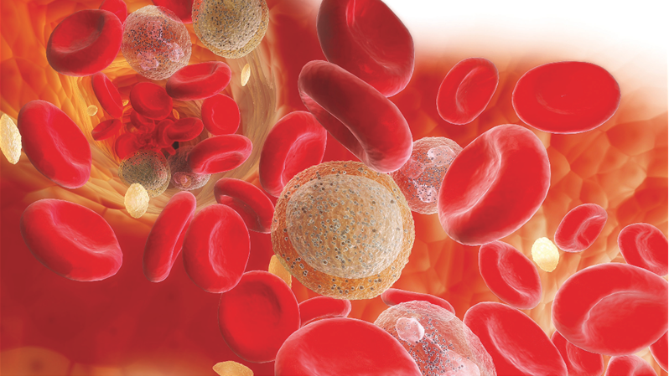
Management of Preoperative Anemia in Cardiac Surgery
Rasoul Azarfarin MD, FACC
Professor of Cardiac Anesthesiology
Rajaie Cardiovascular Medical & Research Center
Feb 29, 2018

Slide 3
Journal of Cardiothoracic and Vascular Anesthesia, Vol 30, No 4 (August), 2016: pp 896–900
The Prevalence and Impact of Preoperative Anemia in Patients Undergoing Cardiac Surgery for Rheumatic Heart Disease (India)
Borde Deepak, et al.
Prevalence of preoperative anemia as per WHO (Hb< 13 g/dL for men and <12 g/dL for women) definition was 51.95%.
Mild (male11-12.9g/dL,female11-11.9 g/dL) and moderate (8-10.9g/dL forboth sexes) anemias were present in 33.15% and 18.80%, respectively.
The primary endpoint was in-hospital mortality, with an incidence of 26 (6.9%); the incidence of mortality in non-anemic, mildly anemic, and moderately anemic patients was 5.59%, 4.50%, and 19.04% (p = 0.003), respectively.
Patients with moderate anemia utilized an average of 3 units of packed
cells compared to 1 in non-anemic patients (p = 0.0001).
On adjusting for Euro- SCORE II and severity of anemia, perioperative packed cell transfusion was associated with significant odds (odds ratio 2.218; confidence interval 1.517-2.986; p o 0.0001) for mortality

Slide 4
Hung M,BesserM,SharplesLD,etal.
The prevalence and association with transfusion, intensive care unit stay and mortality of pre-operative anaemia in a cohort of cardiac surgery patients.
Anaesthesia 66:812-818,2011
In a study from the UK, the prevalence of preoperative anemia was 54.4% (1463⁄2688), according to the WHO definition. Preoperative anemia was a strong predictor of increased transfusion requirement, risk of ICU stay, and death during cardiac surgery

Slide 5
Journal of Cardiothoracic and Vascular Anesthesia, Vol 30, No4 (August), 2016: pp 901–908
The Relationship Between Preoperative Hemoglobin
Concentration, Use of Hospital Resources, and
Outcomes in Cardiac Surgery (UK) George Hallward et al.
The overall prevalence of anemia was 32% (629/1,972 patients).
For every 1-unit Increase in hemoglobin (g/dL), blood transfusion requirements were reduced by 11%, 8%, and 3% for red blood cell units, platelet pools, and fresh frozen plasma units, respectively (adjusted incident rate ratio 0.89 [95%CI0.87-0.91], 0.92 [0.88-0.97], and 0.97 [0.96-0.99]).
For each 1-unit increase in hemoglobin (g/dL), the probability (overtime) of discharge from the ICU and hospital increased (adjusted hazard ratio estimates 1.04[1.00-1.08] and 1.12 [1.12-1.16]

Slide 6
J Pak Med Assoc. 2011 Nov;61(11):1091-5.
The incidence of anaemia in adult patients with cardiovascular diseases in northwest Iran.
Alizadehasl A, Golmohammadi Z, Panjavi L, Mahmoodmoradi S, Azarfarin R.
Among 12031 patients, 2913 (24.2%) were anaemic and 9118 were non-anaemic.
The analysis of prevalence of anaemia showed that the highest proportion belonged to peripheral vascular disease with the prevalence rate of 56.1% followed by congenital heart disease (36.6%), heart failure (36.0%), valvular heart disease (34.0%) and pulmonary vascular disease (33.7%).
There is a high rate of anaemia prevalence in age group older than 70 years.
Multivariate logistic regression analysis revealed, being non-smoker, history of cardiac surgery, lower ejection fraction (< 40%) and serum creatinin level > 1.2 mg/dl as independent predictors of anaemia.

Slide 7
Of patients with preoperative anaemia, 23.1% had iron deficiency anaemia IDA, 6.6% had possible IDA
70.3% had possible anaemia of chronic disease ACD.
Of the patients with possible ACD, 30% had a ferritin <100 µg/l, representing limited iron stores or coexisting absolute iron deficiency in the setting of chronic disease.
In addition, 46.2% of those with possible ACD had iron studies indicative of functional iron deficiency.

Slide 8
J Thorac Cardiovasc Surg 2016;152:1412-20
Does the severity of preoperative anemia or blood transfusion have a stronger impact on long-term survival after cardiac surgery?
Christian von Heymann, Lutz Kaufner, M Sander, C Spies, K Schmidt Hans Gombotz, Klaus-Dieter Wernecke, Felix Balzer,

Slide 9
J Thorac Cardiovasc Surg. 2016 Nov;152(5):1412-1420. doi: 10.1016/j.jtcvs.2016.06.010.
Does the severity of preoperative anemia or blood transfusion have a stronger impact on long-term survival after cardiac surgery? von Heymann C¹, Kaufner L², Sander M², Spies C², Schmidt K², Gombotz H³, Wernecke KD⁴, Balzer F².
Preoperative anemia (mild anemia: hazard ratio [HR], 1.441; 95% confidence interval [CI], 1.201-1.728; severe anemia: HR, 1.805; 95% CI, 1.336-2.440) and intraoperative transfusion (HR, 1.340; 95% CI, 1.109-1.620) were associated with decreased long-term survival.

Slide 11
The estimated prevalence of anaemia is up to 50% of patients in some hospitals.
Nutritional deficiencies of iron, folate and/or vitamin B12 contribute to approximately a third of the cases preoperatively, whereas functional iron deficiency (FID) or iron restriction appears to be more common.
FID exists when there is failure of the bioavailability of iron for erythrogenesis.
The mechanism occurs via inflammatory mediators induced by pre-existing illness or comorbid disease.
The cost of transfusing a single unit of blood has been estimated to be £170 for the first unit, with the subsequent unit costing £162.

Slide 12
Hepcidin and Anemia
Hepcidin, an important regulator of iron homoeostasis, is upregulated under inflammatory conditions and prevents export of iron from cells. This results in the increased uptake and retention of iron from the circulation by the reticular endothelial system, thus reducing bioavailability of iron for erythrogenesis
We will be examining different haematological variables Full Blood Count, ferritin and C reactive protein and especially hepcidin and Renal function tests
In our substudy, we are exploring Total HB Mass (tHbmass) as an alternative marker in determining oxygen carrying capacity (Hb is traditionally used, studies have shown that Hb may not be a reliable or accurate measure as it can be influenced by fluid shifts (eg, blood loss) or haemodilution, which is commonly observed in ICU)

Slide 13
Correction of Preoperative Anemia
A thorough history and physical examination are also essential for identifying any comorbidities that are potential causes of anemia.
New symptoms or signs related to anemia, as well as nutritional intake, herbal remedies, medical history, family history, alcohol intake, and current medications, in particular salicylates, nonsteroidal anti inflammatory drugs, and Coumadin.
In addition, a stool specimen for occult blood should be obtained.
It is recommended correction of nutritional anemia with iron (Oral or IV), vitamin B12, folate supplementation, or administration of recombinant human erythropoietin (rHuEPO).
Iron supplementation is indicated in the presence of confirmed iron deficiency anemia, as documented by the following laboratory values: hemoglobin <12 g/dL in a female or <13 g/dL in a male, MCV <80 fl, and ferritin <12 ng/mL or transferrin saturation <15%
If iron deficiency is confirmed, gastrointestinal evaluation is recommended for any patient except menstruating women.

Slide 14
Based on the time interval required for anemia evaluation and management, the panel considered a 30-day interval to be optimal in the elective surgical patient.
The panel further recommended that the patient’s target hemoglobin before elective surgery should be within the normal range (normal female ≥12 g/dL, normal male ≥13 g/dL).
Unexplained anemia should always be considered as secondary to some other process and, therefore, elective surgery should be deferred until an appropriate diagnosis is made.

Slide 15
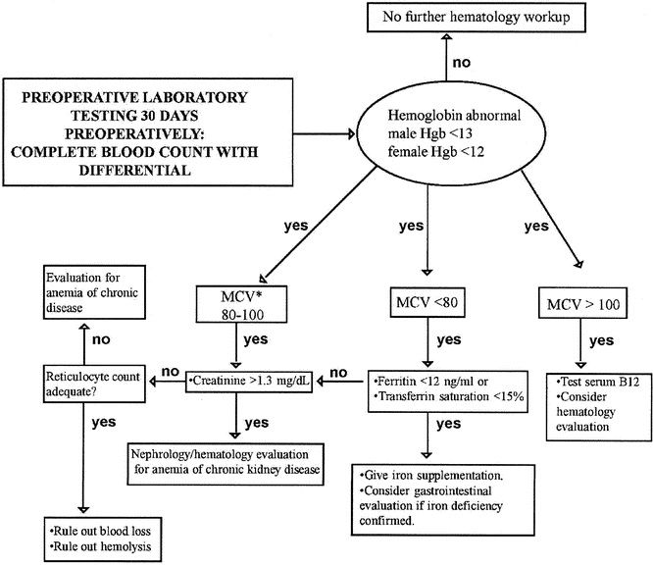

Slide 16
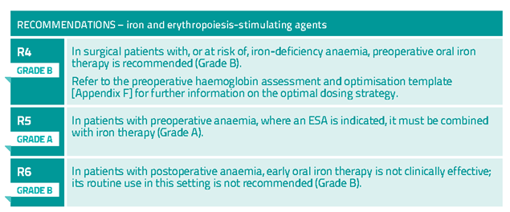

Slide 17
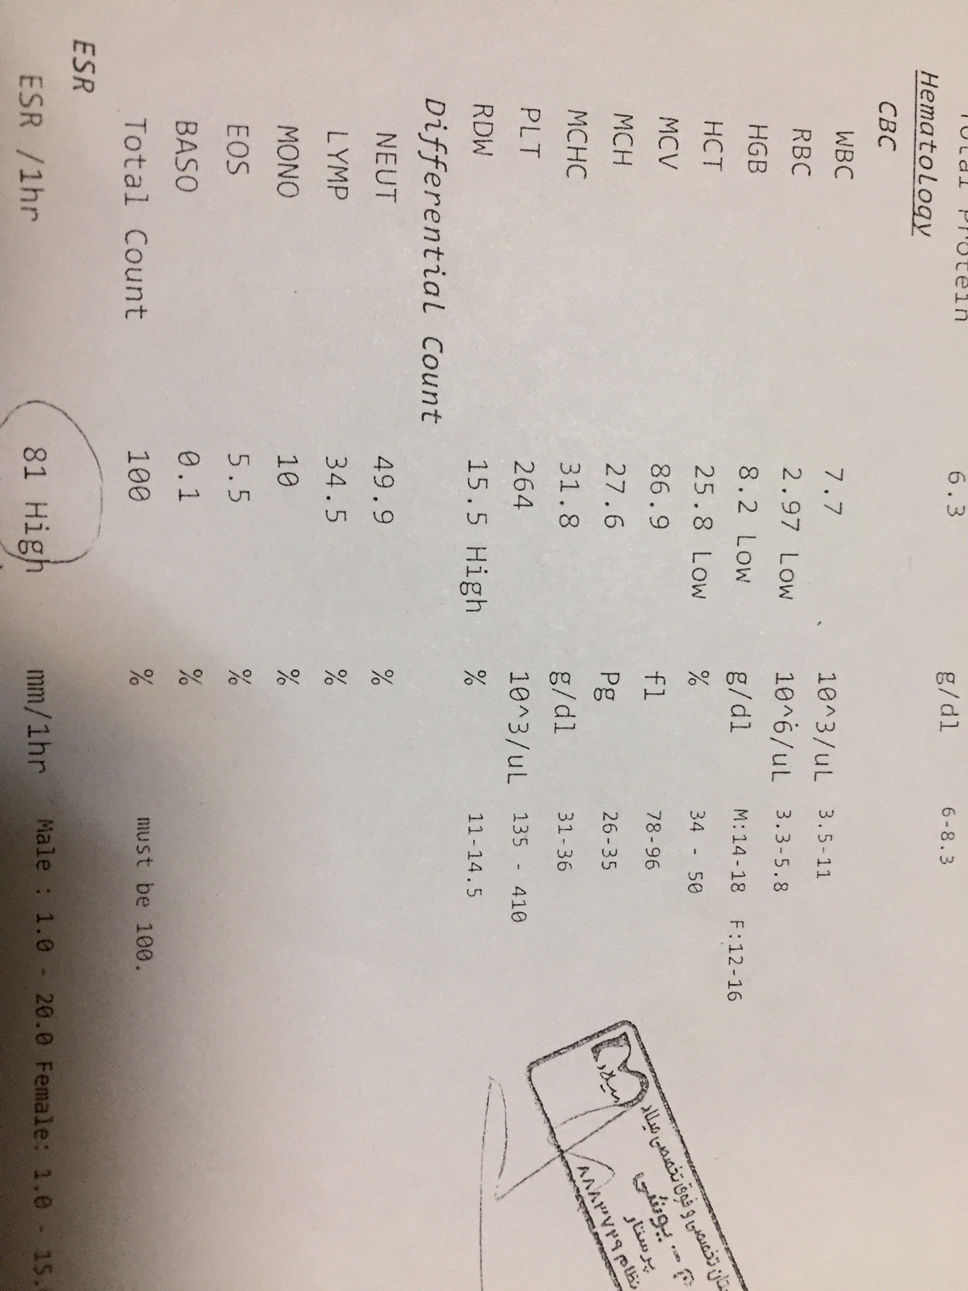
The patient was 59 years old diabetic female that candidate CABG due to CAD (3VD).

Slide 18
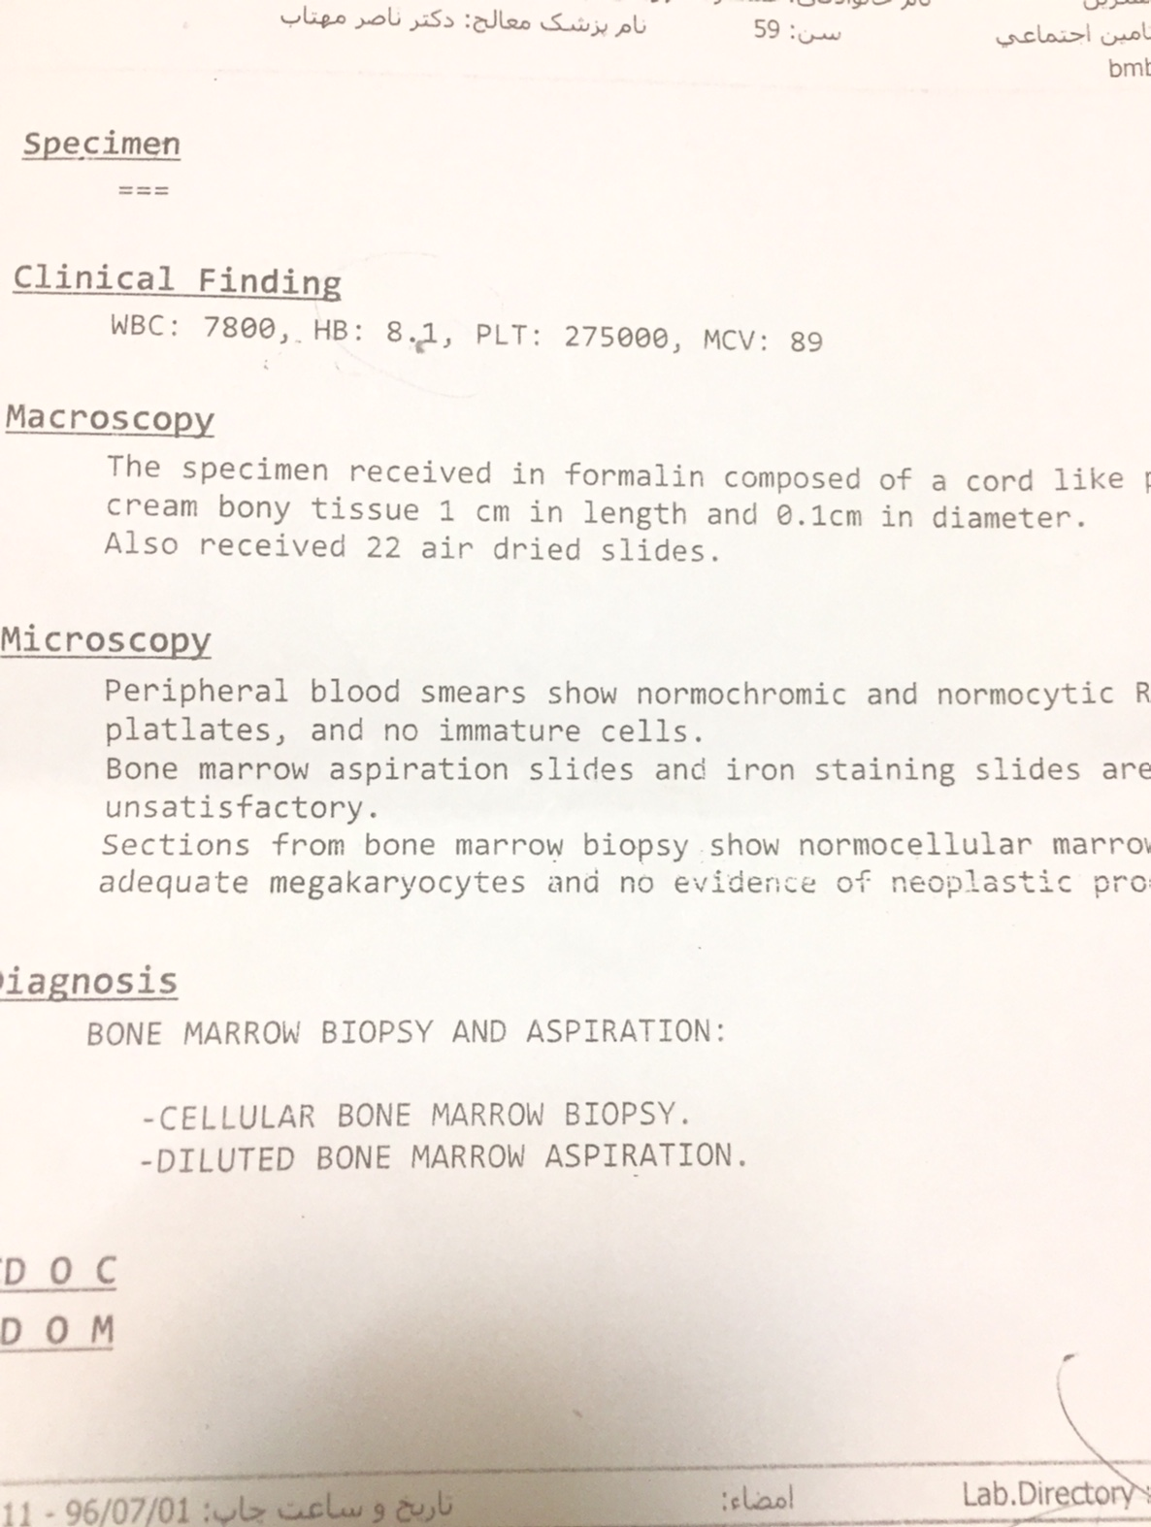



Slide 19
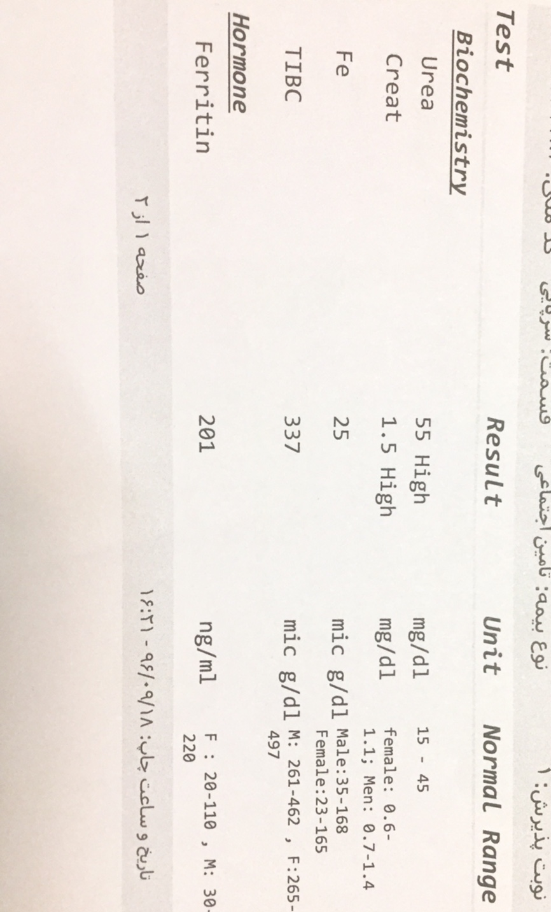

Slide 20
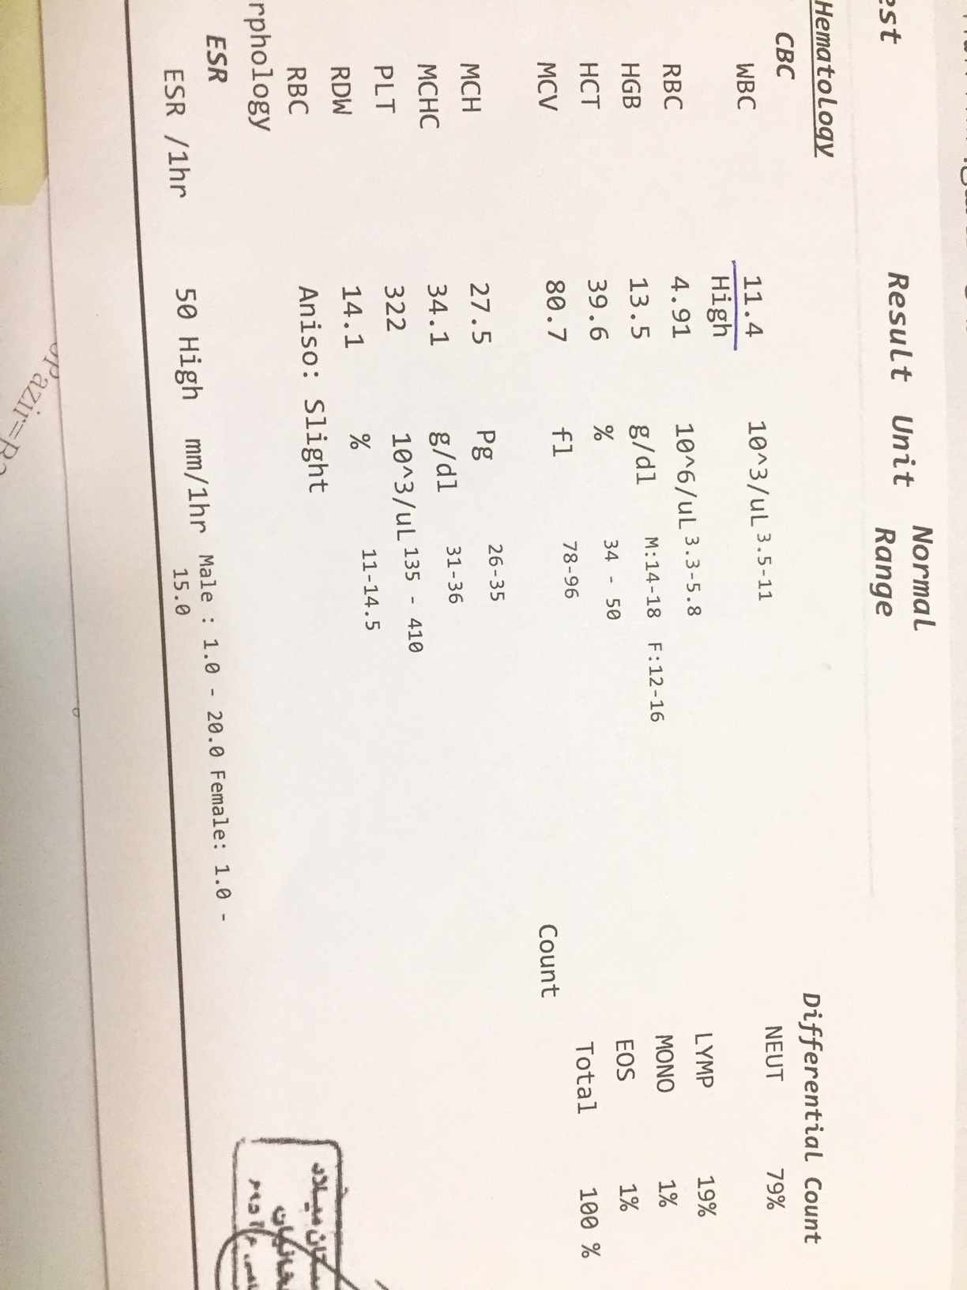
She underwent treatment with Erythropoietin 4000 U twice a week for 6 weeks.

Slide 21
Preoperative recombinant human Erythropoietin in anemic surgical patients
Terri G Monk Critical Care 2004, 8(Suppl 2):S45-S48
In a single-blind, randomized study of patients undergoing CABG surgery, patients treated with low dose (100 units/kg) rHuEPO for 4 days before surgery received less than half the amount of autologous blood (P < 0.01) as compared with the control group.
Patients undergoing major orthopedic surgery who received rHuEPO 300 units/kg per day for 10 days preoperatively, on the day of surgery, and 4 days postoperatively had a nearly six-fold reduction in allogeneic transfusion risk as compared with patients who received placebo
rHuEPO administered weekly (600 units/kg per week) for four doses beginning 21 days.

Slide 22
Anesthesiology. 2011 Nov;115(5):929-37. doi: 10.1097/ALN.0b013e318232004b.
Effect of Single Recombinant Human Erythropoietin
Injection on Transfusion Requirements in Preoperatively Anemic Patients Undergoing Valvular Heart Surgery
Young-Chul Yoo, Jae-Kwang Shim, Jong-Chan Kim, Youn-Yi Jo, Jong-Hoon Lee, Young-Lan Kwak
The erythropoietin group received 500 IU/kg erythropoietin and 200 mg iron sucrose intravenously 1 day before the surgery.
Transfusion occurred in 32 patients (86%) of the control group versus 22 patients (59%) of the erythropoietin group (P = 0.009).
The mean number of units of packed erythrocytes transfused per patient during the surgery and for 4 postoperative days (mean ± SD) was also significantly decreased in the erythropoietin group compared with the control group (3.3 ± 2.2 vs.. 1.0 ± 1.1 units/patient, P = 0.001). The reticulocyte count was significantly greater in the erythropoietin group at postoperative days 4 (P = 0.001) and 7 (P = 0.001).

Slide 23
Anesth Analg. 2017 Oct 19. A Review Article
Perioperative Patient Blood Management to Improve Outcomes. Desai N¹, Schofield N, Richards T.
Anemia is common in elective surgery and is an independent risk factor for morbidity and mortality.
The optimization of red blood cell mass; reduction of blood loss and bleeding; and optimization of the patient's physiological tolerance toward anemia.
Preoperative anemia is most commonly caused by functional iron deficiency and should be treated with oral iron, intravenous iron, and/or recombinant erythropoietin.

Slide 24
Anesth Analg. 2017 Aug 29.
Outcomes in Patients Undergoing Cardiac Surgery Who Decline Transfusion and Received Erythropoietin Compared to Patients Who Did Not: A Matched Cohort Study.
Duce L¹, Cooter ML, McCartney SL, Lombard FW, Guinn NR.
BACKGROUND: Erythropoiesis-stimulating agents, such as erythropoietin (EPO), can be used to treat preoperative anemia. Some studies suggest an increased risk of mortality, thrombotic events, and use in cardiovascular surgery remains off-label.
RESULTS: Fifty-three patients who decline transfusion and received EPO were compared to 106 optimally matched control patients who did not receive EPO or red blood cell transfusion in the perioperative period. There was no difference in the primary outcome (P = .12) and mortality was zero in both groups. The EPO group had a higher mean preoperative Hb (13.91 g/dL vs 13.31; P = .02) and a smaller change in Hb from baseline (-2.65 vs -3.60; P = .001). The incidence of AKI (47.17% vs 41.51%; P = .49) was similar and there was no significant difference in all other outcomes, including time to extubation, hospital LOS, or intensive care unit LOS.
CONCLUSIONS:In this retrospective matched cohort study of patients declining transfusion and receiving EPO matched to control patients, there were no clinically meaningful differences in the outcomes.

Slide 25

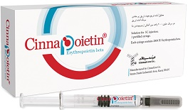
Male Hb<13 mg/dl
Female Hb<12 mg/dl

